Slide 1
Robots for Everyone
(Modular/Low-cost/Swarm Robots)

Slide 2
Introductions
Welcome!
Today’s workshop will cover:
The “why” of low-cost swarm robots
Basic circuitry concepts
Basic programming with an Arduino
Making a robot that can sense, think, and act

Slide 3
Why low-cost/swarm robots?

Slide 4
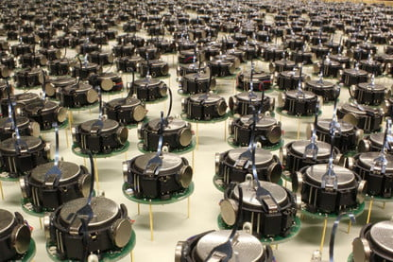
Swarm Robots
Involve large numbers of robots working together
Common applications include:
Disaster relief
Distributed sensing
Diversifying robot abilities

Slide 5
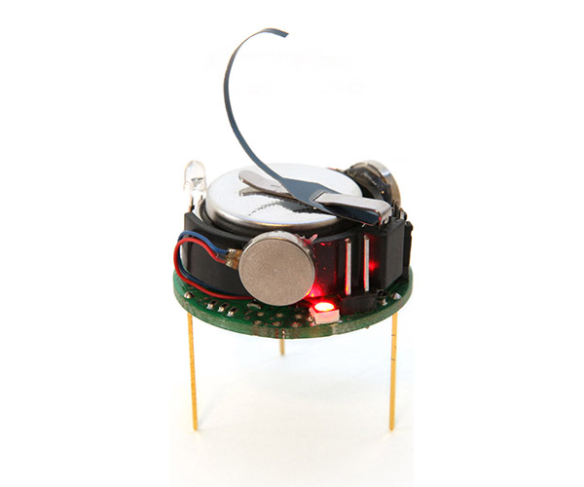
Kilobots
The Kilobot robot (at right) is used in swarm robotics to study:
Collective transport
Human-swarm interaction
Self-assembly

Slide 6
Build-a-bot?
In large swarms, robots like the Kilobot often need to be low-cost. This makes them ideal for outreach!
Today, we’ll basically be building a Kilobot-like robot from the ground up

Slide 7
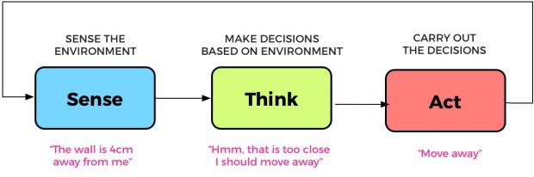
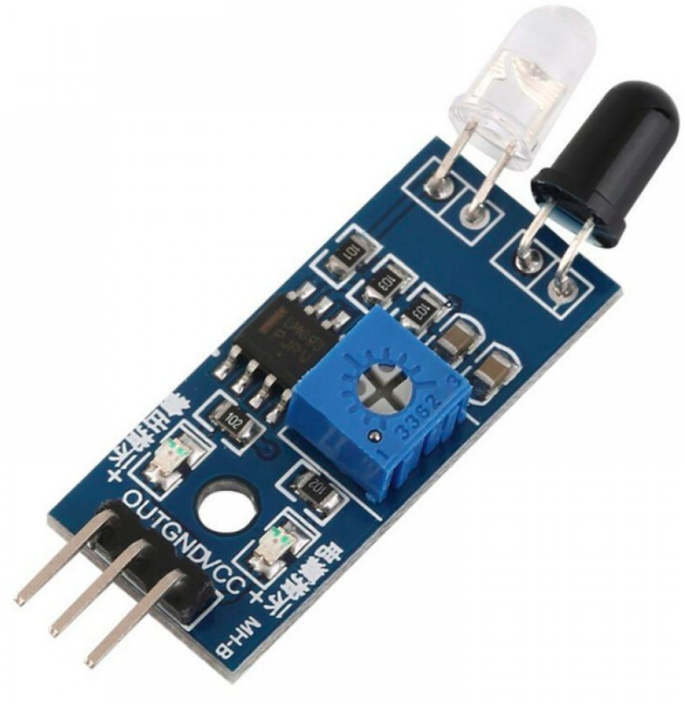
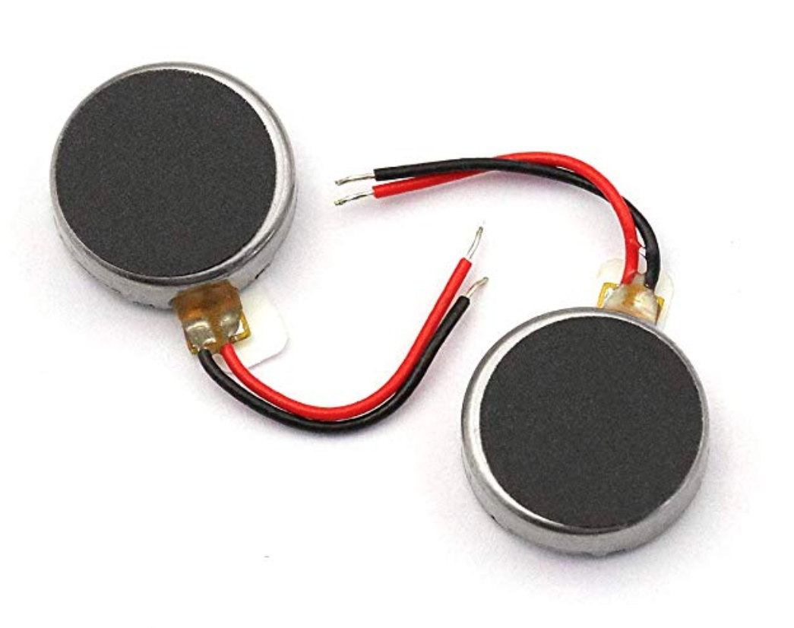
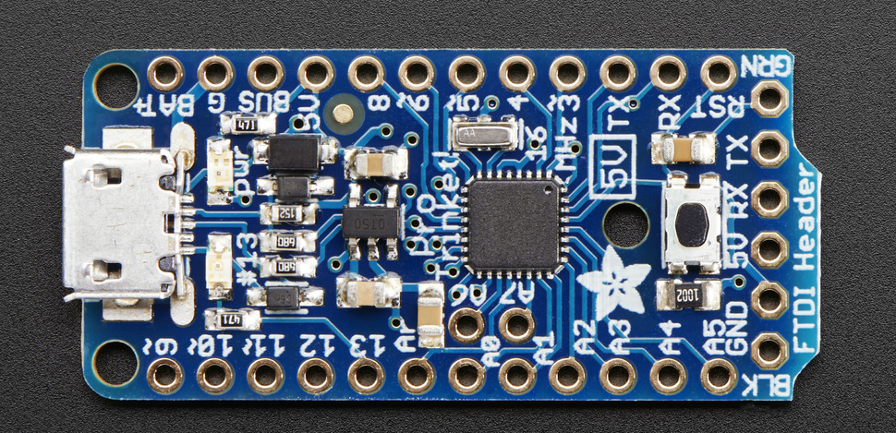
Kilobots and Other Robots (Including Ours)

Slide 8
How can we make a low-cost robot sense, think, and act?

Slide 9
Act, Think, Sense?
We’ll work backward, helping our robot to
Move with motors
“Think” with an Arduino Trinket
Sense with an infrared sensor

Slide 10
Before Acting: Important Circuitry Review
Before moving our own robot, we’ll need to cover:
Voltage and current
Solderless breadboards
MOSFETs
Motors

Slide 11
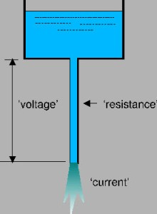
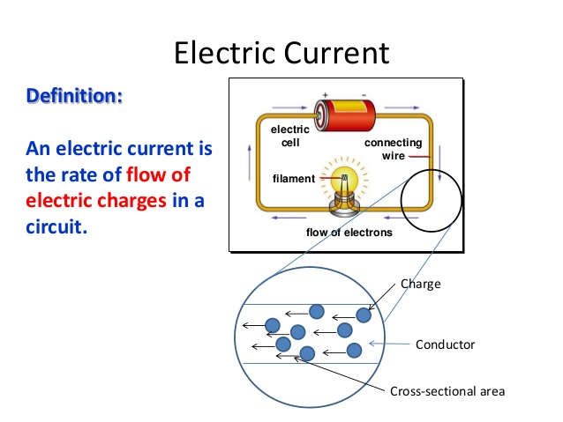
Voltage and Current

Slide 12
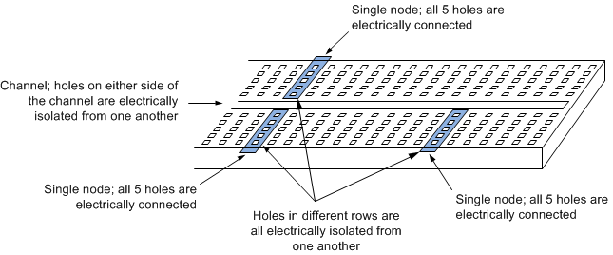
Breadboard and their Nodes

Slide 13
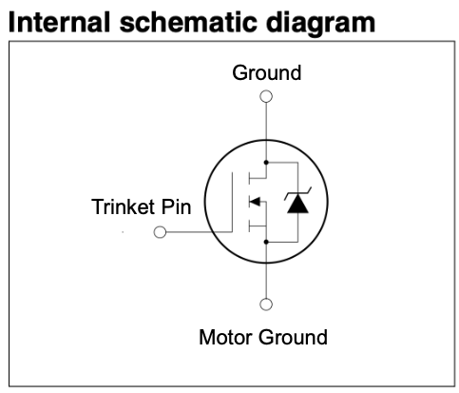
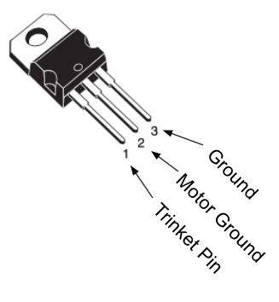
MOSFET Schematic

Slide 14
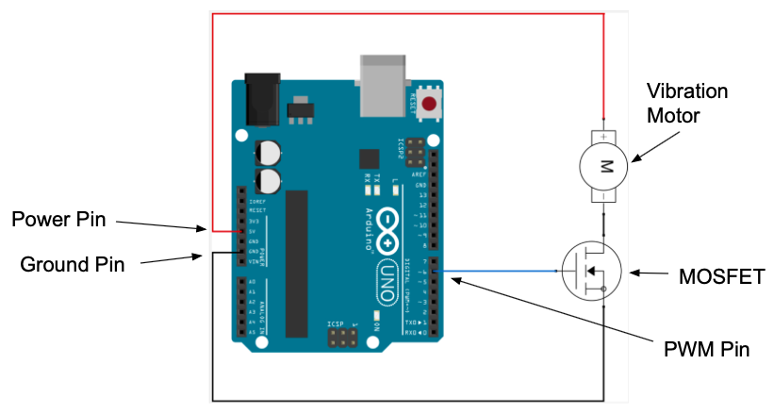
Example Circuit for Powering One Motor

Slide 15
Before Thinking: Arduino Programming
Before our robot can think, we need to step through:
Installing Arduino (if desired, instructions on handout)
The Arduino Trinket pinout diagram
How to upload code to the Trinket microcontroller

Slide 16
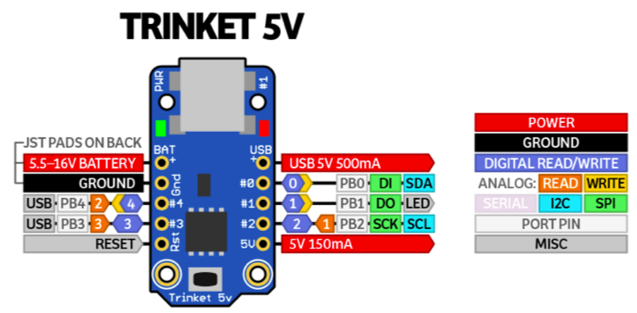
Arduino Trinket Pinout Diagram

Slide 17
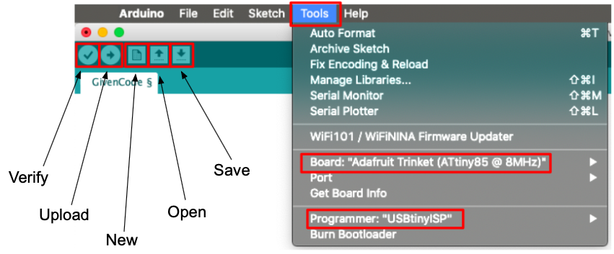
Uploading Programs to Arduino

Slide 18
Before Sensing: Learning about IR Sensor
We’ll gain some experience with an infrared sensor with the guidance from our “Help Packet”

Slide 19
Let’s try it!

